Slide 1

BKV Group – LGBTQIA+ Pride month
Leslie McMurray – (she/her) Transgender Education & Advocacy Associate

Slide 2

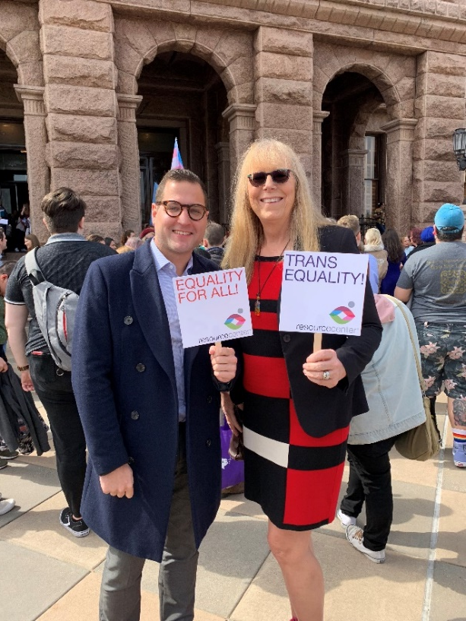

Your Presenters
Leslie McMurray
Lmcmurray@myresourcecenter.org

Slide 3
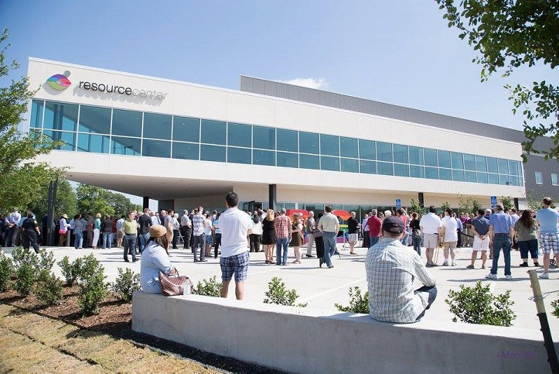

Resource Center
Resource Center is a trusted leader that empowers the lesbian, gay, bisexual, transgender and queer/questioning, Intersex, Asexual (LGBTQIA+) communities and all people affected by HIV through improving health and wellness, strengthening families and communities and providing transformative education and advocacy.

Slide 4
At the end of this training, we will have…
Provided basic terminology associated with the LGBTQIA+ community along with various Pride Flags.
Explain the importance of pronouns (and what to do if you make a mistake)
Touch on overt and covert forms of homophobia & transphobia
Discuss the origin of Pride month
Provide some tips to be allies and champions

Slide 5
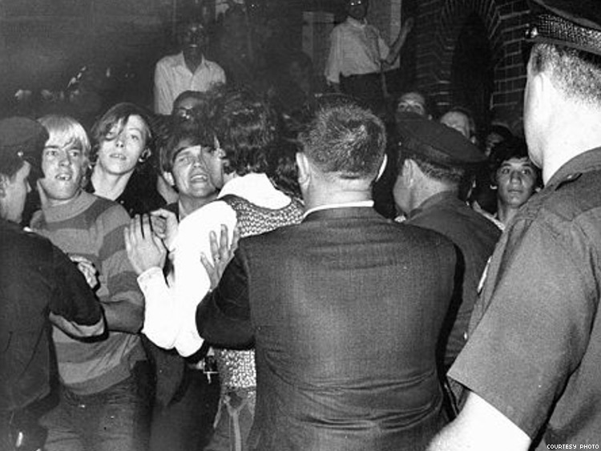
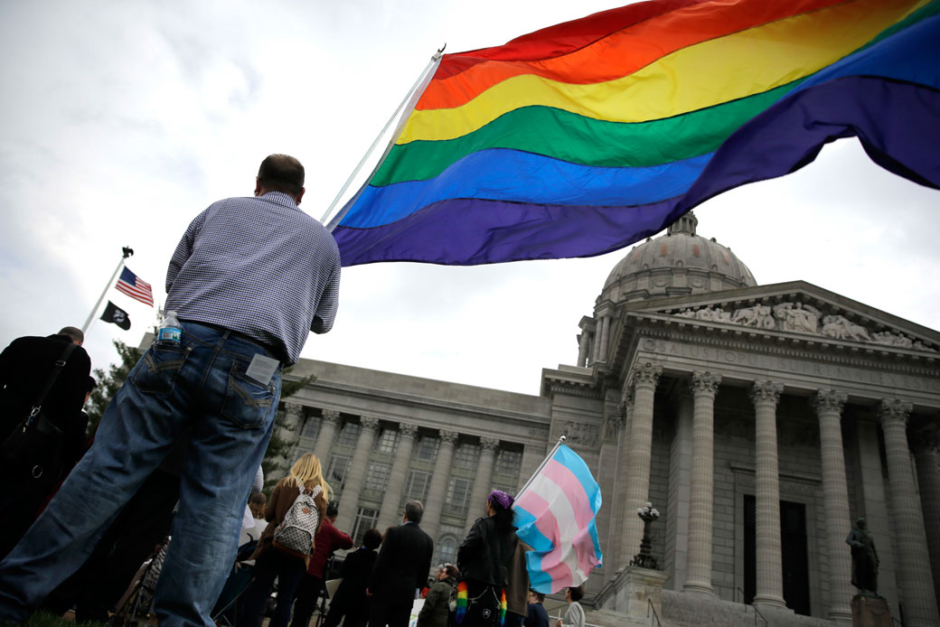
The first “Pride” was a riot
Criminalization era – not so long ago!
Idea and importance of public space
NCOD as show of solidarity and support

Slide 6
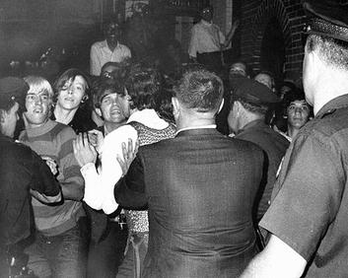
LGBTQ Historical Figures and Events
Stonewall: June 1969
Incited by continued police raids at known gay bar
Lasted for nearly a week with clashes taking place daily
Commemorated yearly with pride

Slide 7
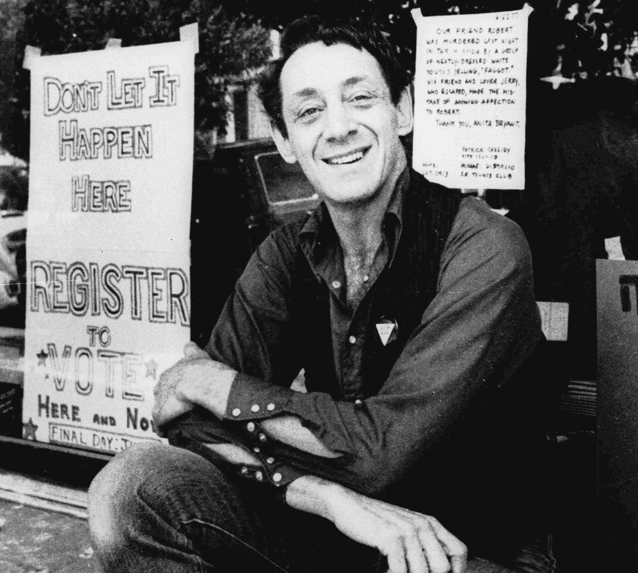
LGBTQ Historical Figures and Events
Harvey Milk: first highly open gay elected official
Elected to San Francisco Board of Supervisors in 1978
Assassinated after only ten months in office

Slide 8
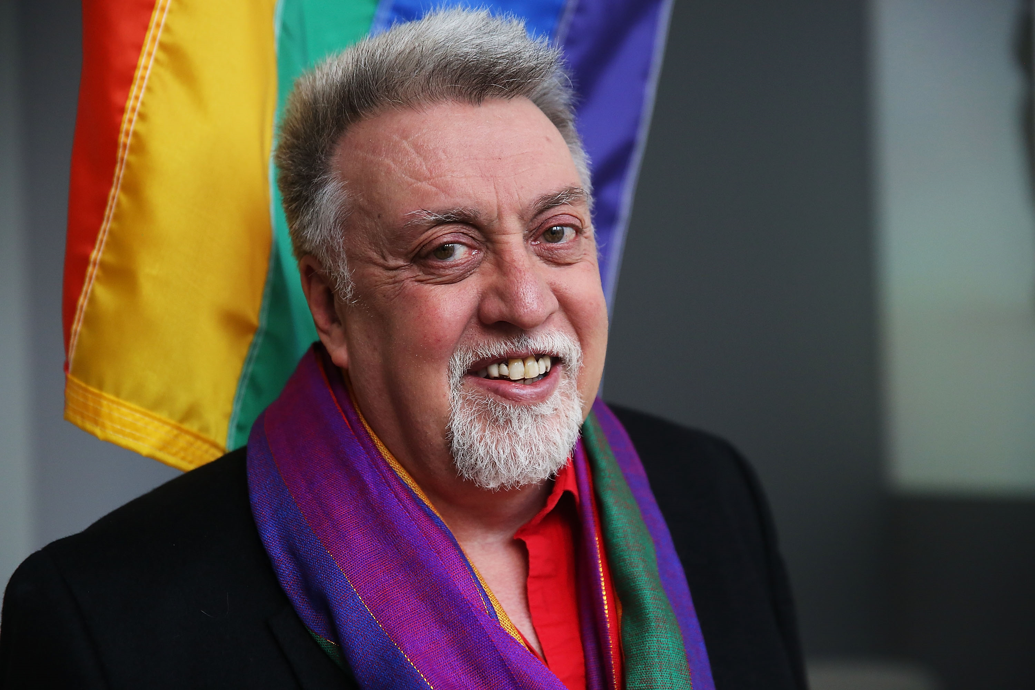
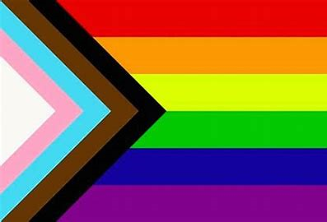
LGBTQ Historical Figures and Events
Gilbert Baker’s rainbow “pride” flag: 1978
Importance of flag and
how it has evolved
No profit made –
gift to the community

Slide 9
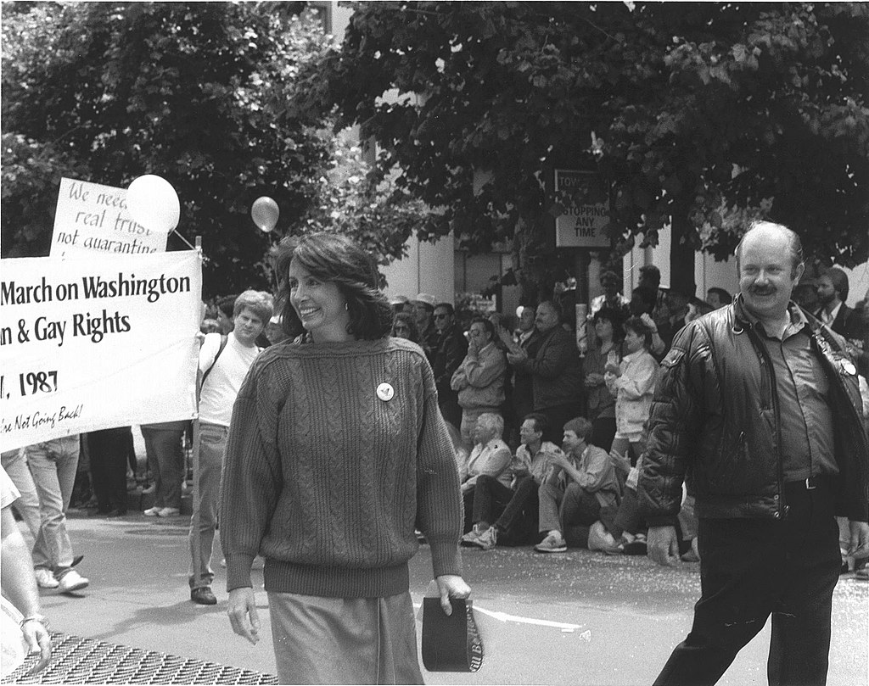

1987 March on Washington
Midst of HIV/AIDS epidemic
Display of HIV/AIDS Quilt
Political aims of march

Slide 10

Language matters
LGBTQIA+
  Lesbian, Gay, Bisexual, Transgender and Queer/Questioning, Intersex, Asexual; can also be GLBTQ
Sexual Orientation
  A person’s enduring physical, romantic, emotional and spiritual attraction to another person
  Everyone has a sexual orientation

Slide 11

Language matters
Bisexual
  An individual who is physically, romantically
  and/or emotionally attracted to two genders
  Bisexuals need not have had sexual experience
  with both men and women
  In fact, they need not have had any sexual experience at all to identify as bisexual

Slide 12

Language matters
Asexual
A person who experiences below average sexual attraction
Ace
An umbrella term referring to individuals who identify on the asexual spectrum (demi, gray-a or gray-ace as examples)
Pansexual
Someone who does not limit their attraction relative to sexual orientation or gender identity

Slide 13

Language Matters
Heterosexual
  An adjective used to describe people whose enduring physical, romantic and/or emotional attraction is to people of the opposite sex

Slide 14
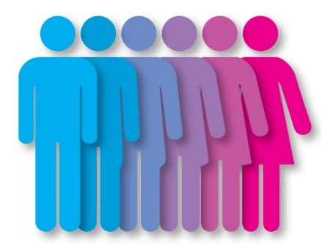
Language matters
Gender Identity
The gender with which one identifies
In most people, gender identity matches sex assigned at birth
When it doesn’t, the umbrella term transgender is used

Slide 15
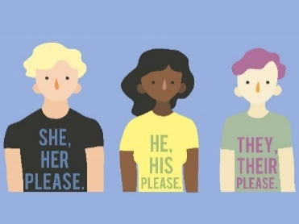
Language matters
Transgender clarified
Gender Identity is different from sexual orientation
IDENTIFICATION is the key for a transgender person; surgery is not the determining factor
Outward appearance may or may not be helpful in determining how someone identifies
If there is uncertainty, respectfully ask which pronouns to use
A person’s gender identity is considered protected medical information

Slide 16
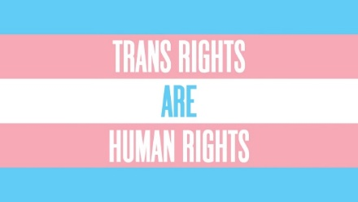
Language matters
Transgender is an adjective, not a noun
Trans men are men
Trans women are women
Variants: Trans-masculine, trans-feminine, masculine of center…
Cisgender
A person whose self-identity conforms with the gender that corresponds to their biological sex; not transgender

Slide 17

Language matters
Societies like ours tend to recognize just two genders, male
and female. The idea of two genders is called “gender binary.”
Gender non-binary or gender-diverse
Term people use to describe genders that don’t fall into one of these two (binary) categories, male or female
Facts
You don’t have to understand what it means for someone to be non-binary to respect them.
Being respectful to a non-binary person includes using the correct name and pronouns.
Many times “they/them” pronouns are used.

Slide 18

Language matters
Genderqueer
Another catch-all for gender identities that fall outside the binary
Pangender, gender fluid, non-gendered, agender
Gender Identity Disorder (Outdated) Gender Dysphoria
Transgender vs. Transsexual

Slide 19
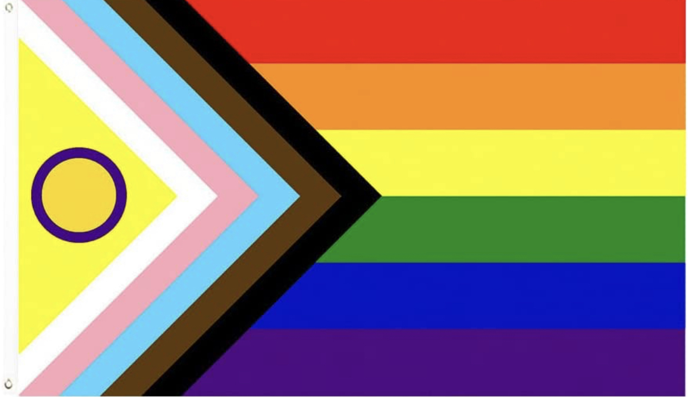
Language matters
Intersex
Covers a pretty wide area where a person is born with reproductive or sexual anatomy that doesn’t fit neatly into the box of “male” or “female.”

Slide 20
To Sum Up
Sexual Orientation
Who you go to bed with
Gender Identity
Who you go to bed as

Slide 21
Language Matters
Gender Expression
The way in which a person expresses their gender identity, typically through their appearance, dress, and behavior
Gender identity is internal
while gender expression is external.

Slide 22
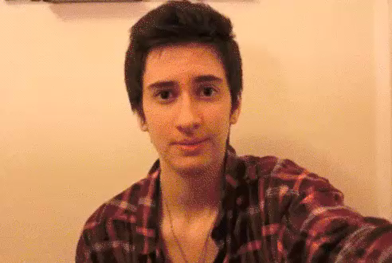
Language Matters
Transition
The process of transitioning the body to match one’s internal gender – Stopping the dysphoria
There is no one right way – it’s very personal, and asking about whether someone is planning on having or has had surgery or any medical procedure is inappropriate

Slide 23
Language Matters
Transition policies for transitioning employees or students might include:
Personal transition plan
Correct names/pronouns on forms and documents
Restroom and locker room accessibility
Dress codes

Slide 24
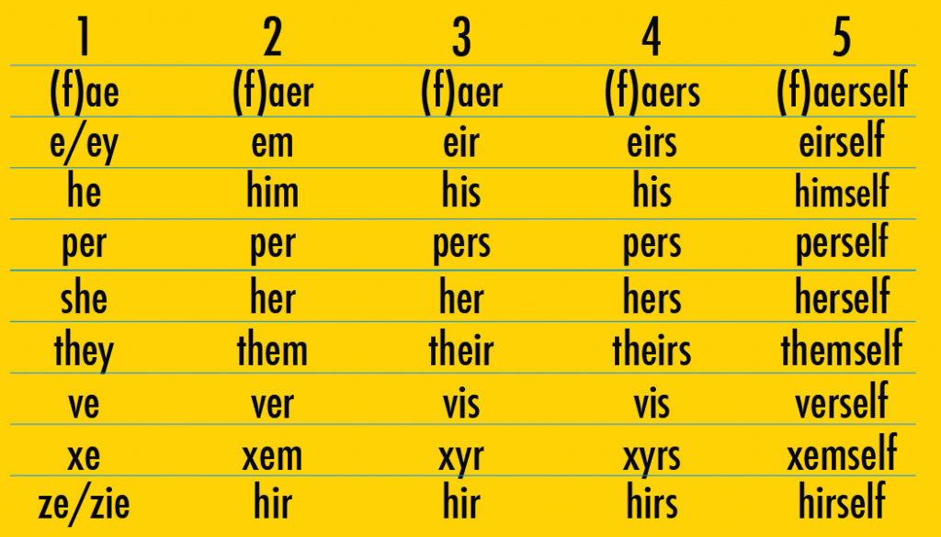
What are Pronouns?
Pronouns
  They really matter! {he, she, they, zhe, hir} If someone tells you their pronouns – please use them. Getting misgendered hurts like a slap in the face.

Slide 25
Pronoun Do’s & Don’ts
  Do
  Recognize that everyone has pronouns – not just trans people. Asking pronouns is very important , both so that someone is not mis-gendered but also to trans people are not the only ones who feel the need to share their pronouns.
  Ask people the pronouns they use when you ask their name – bear in mind, pronouns can sometimes change.

Slide 26
Pronoun Do’s & Don’ts
  Don’t:
  Refer to pronouns such as “They/Them” as gender neutral pronouns. While some trans people may identify as gender neutral, many see themselves as gendered. “Non-Binary pronouns” is better language
  Describe pronouns as “preferred” or as “male or female”
  Indicate that you don’t care which pronouns are used. This can reinforce the privilege many cis people have in not worrying about ever being misgendered.

Slide 27
Pronouns
Being “outed” even inadvertently, can put us in harms way
Privilege is never having the wrong pronouns used. Sharing yours takes nothing from you but can make us feel more comfortable around you
What if I make a mistake?

Slide 28
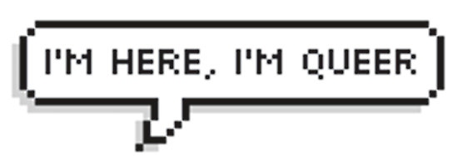
Additional Useful Terms
Queer
Traditionally, a derogatory term for LGBTQIA+ persons and others; currently used by some LGBTQIA+ persons as a term of empowerment
Questioning
A person who has questions about their sexual orientation or gender identity
LGBTQIA+ or GLBTQIA+ (the Q represents Queer or Questioning)
Intersex: Someone born with reproductive or sexual anatomy that doesn’t fit the box of male or female.

Slide 29

Language Matters
LGBTQQIAAP
Lesbian, Gay, Bisexual, Transgender, Queer, Questioning, Intersex, Asexual, Allies, Pansexual

Slide 30

Language Matters
AVOID
Sexual preference
Lifestyle/alternative lifestyle
Homosexual
Dead-Naming
Transvestite/tranny
Hermaphrodite
If you are able, call out inappropriate language!

Slide 31
LGBTQIA+ Mental Health Challenges
The mix of pandemic isolation mixed with targeted legislation has seen LGBTQIA+ high school students being far more likely to have attempted or contemplated suicide than their non-queer peers. (CDC)
A study 0f 34,000 LGBTQIA+ youth (13-24) done by the Trevor Project shows that affirming and supportive care literally saves lives.
988 hotline in nationwide use by July 2022
Virtual learning systems in some cases were not agile enough to list chosen names instead of legal names– “outing” some students.

Slide 32
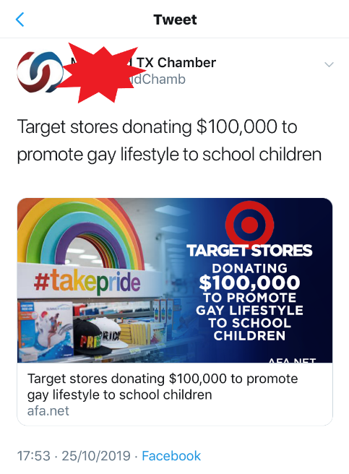
Homo/Transphobic Speech
Language that perpetuates negative
attitudes toward LGBTQ people.
Slurs are an obvious example….
but others are more inconspicuous.
According to NoHomophobes.com….
“So gay:” used on average over 10,000 times daily on Twitter
“No homo:” used on average over 10,000 times daily on Twitter
“Faggot:” used on average over 45,000 times daily on Twitter
“Dyke:” used on average over 4,000 times daily on Twitter

Slide 33
Hetero/Cisnormativity
    Heteronormativity: denoting or relating to a world view that promotes heterosexuality as the normal or preferred sexual orientation
    Cisnormativity: similar to heteronormativity, the assumption that everyone identifies with sex assigned at birth unless otherwise stated.

Slide 34

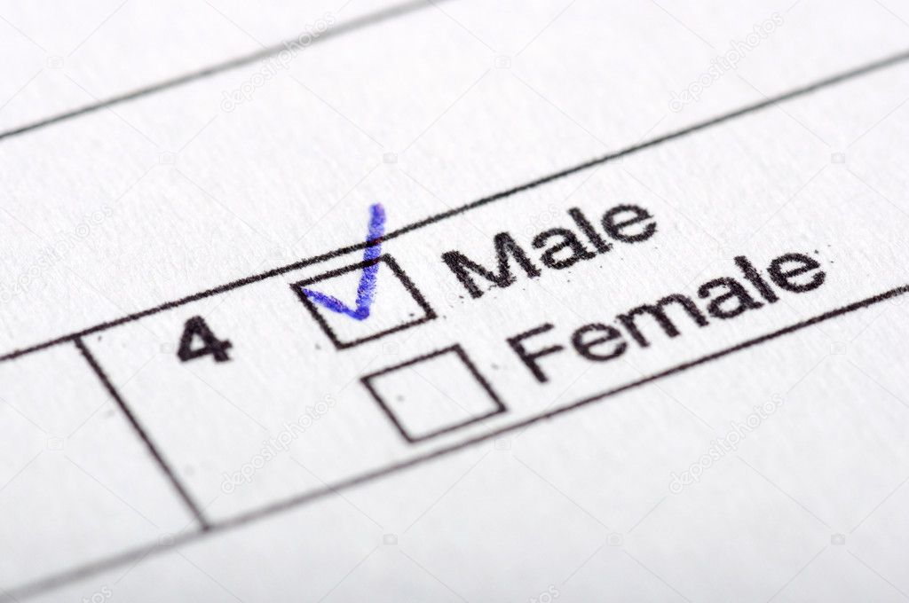
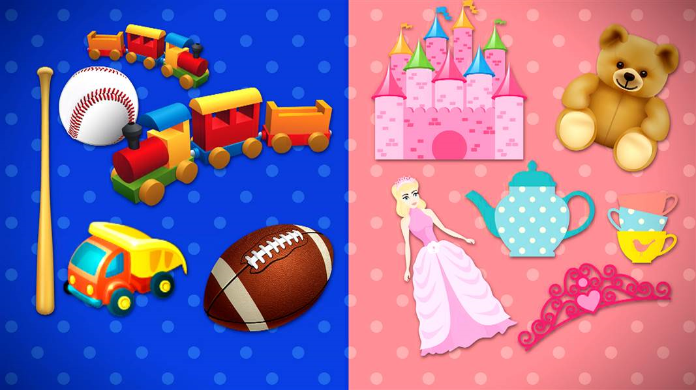
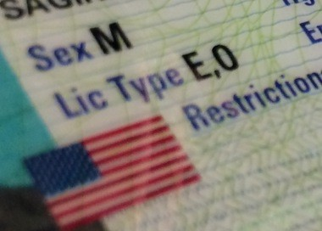
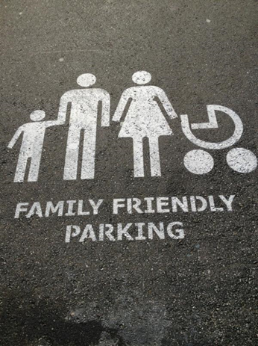
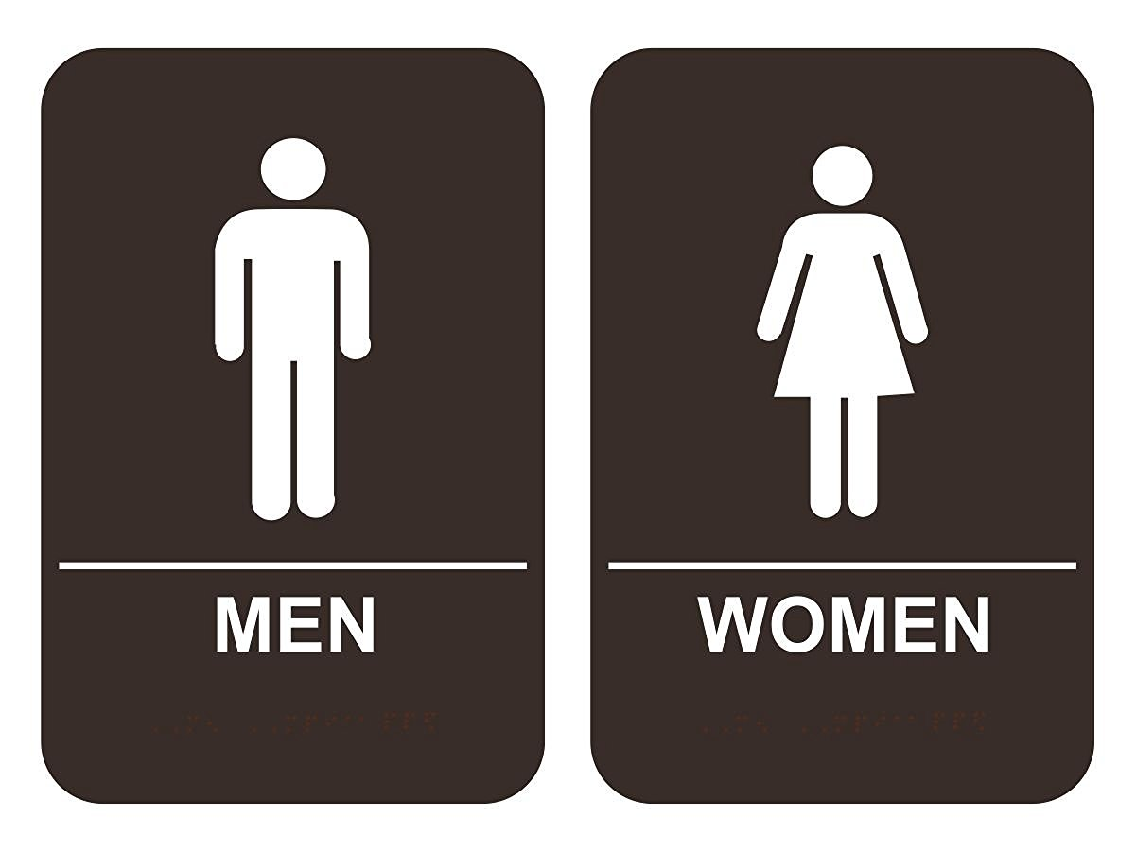
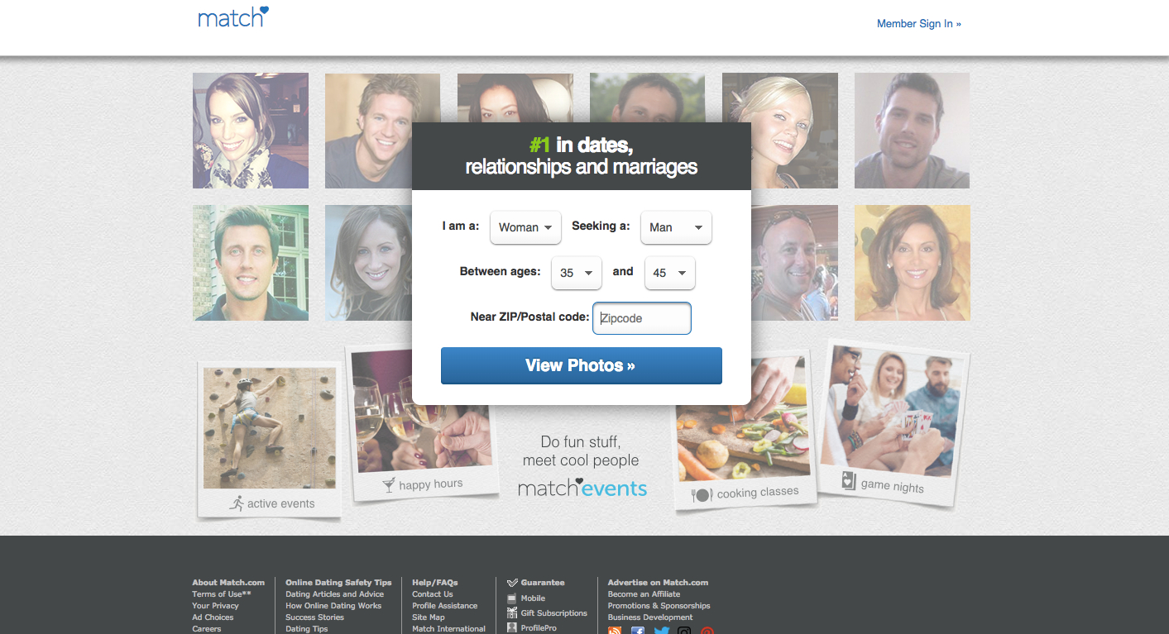
Examples

Slide 35
Hetero/Cisnormativity
By elevating heterosexual and cisgender identities as preferred, heteronormativity and cisnormativity perpetuate “the closet,” stereotypes and foster -phobias and -isms.

Slide 36
Being LGBTQ at Work
“Coming out” is a lifelong process that people do in their own way
Living openly is the last stage in the process and can be uneven
Prior to June 15th 2020 - many LGBTQ people lacked employment non-discrimination protections
Often easier, or safer to stay in the closet
“Covering” – hiding aspects of yourself depending on the situation
Key question: Can your employees bring their “whole self” to work?

Slide 37
Bringing Your “Whole Self” to Work
What type of atmosphere allows employees to bring their whole self to work?
Diversity: presence of differences and populations that have been marginalized.
Inclusion: degree to which diverse individuals are able to fully participate
Equity: promotion of justice, fairness and impartiality

Slide 38
What Makes A Strong Ally?
“Ally” is a verb – it’s something you DO
Being an ally can take many forms
It’s easy for people in marginalized communities to expect too much from allies – after all, we are immersed every day in our struggles
Allies do have the responsibility to learn about the group they are supporting

Slide 39
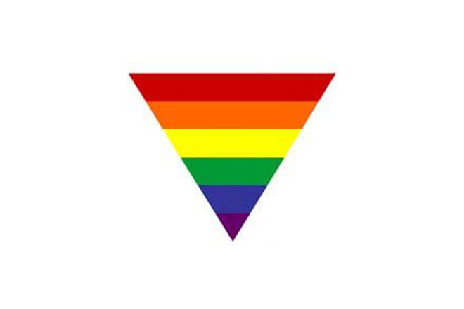
Creating Safe Spaces
Encourage honest dialogues
Remember your role is to help
Respect confidentiality; talk and listen without judgment
Don’t shame people
You won’t be an expert, and it won’t happen overnight

Slide 40
Issue: LGBTQIA+ Employment
SCOTUS decided on June 15, 2020 that Title VII of the Civil Rights Act of 1964 covers LGBTQ employees.
The decision does not add or enumerate sexual orientation or gender identity.
Individual company policies are still important!
Your company is an Equal Opportunity Employer, and all qualified applicants will receive consideration for employment without regard to race, color, religion, sex, sexual orientation, gender identity, gender expression, or national origin.

Slide 41
Issue: Support LGBTQIA+ Workers
Companies must pay attention to policies and culture:
  Establish employee affinity groups, ERG or BRGs.
    Boost employee engagement and foster future leaders
    Get input into setting goals, policies
    More inclusion = more productivity
  Help allies be visible.
    Allow visible displays of support: pins, signs, social media
    Pronouns on email and internal websites
  Engage with the larger community.
    Celebrate LGBT History Month on social media
    Take part in events, job fairs

Slide 42
Any Questions? Shoot us an email!
Lmcmurray@myresourcecenter.org

Slide 43
LGBTQIA+ 101 and Ally Training
Leslie McMurray – (she/her) Transgender Education & Advocacy Associate

